Slide 1
Tech. museum project
Seismology, Geology and Environment

Slide 2
Posters
1. Plate Tectonics
Plate tectonics, theory dealing with the dynamics of Earth’s outer shell the lithosphere that revolutionized Earth sciences by providing a uniform context for understanding mountain building processes, volcanoes, and earthquakes as well as the evolution of Earth’s surface and reconstructing its past continents and oceans.

Slide 3
Continental Drift
Continental drift was a theory that explained how continents shift position on Earth's surface.
Pangaea existed about 240 million years ago. By about 200 million years ago, this supercontinent began breaking up. Over millions of years, Pangaea separated into pieces that moved away from one another. These pieces slowly assumed their positions as the continent we recognize today.

Slide 4
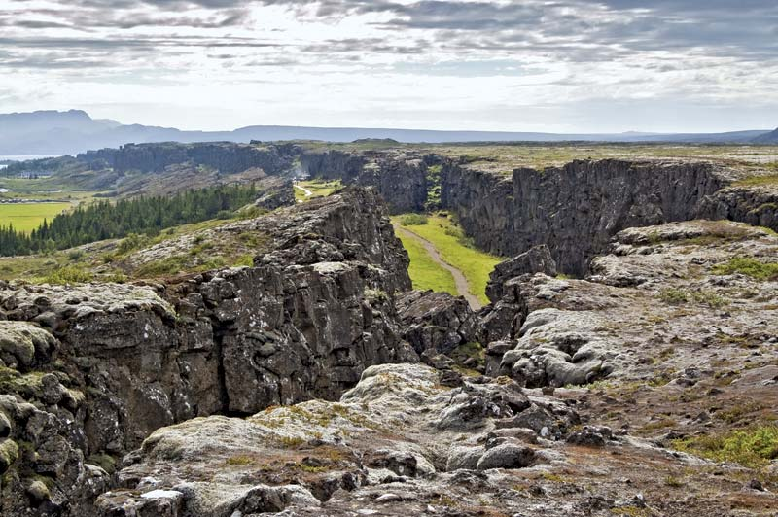
The Thingvellir fracture zone at Thingvellir National Park in southwestern Iceland is an example of a rift valley. The Thingvellir fracture lies in the Mid-Atlantic Ridge, which extends through the center of Iceland.

Slide 5
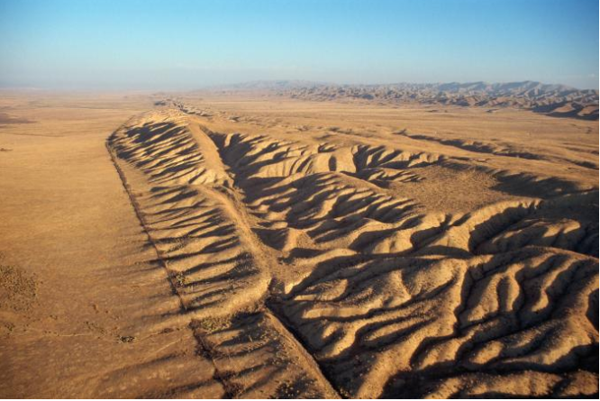
Mountains and a rift can be seen along the San Andreas Fault.

Slide 6
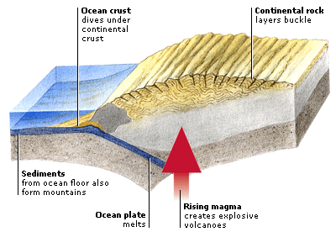
3. Mountain Formation
Mountain Formation is process associated with large-scale movements of the earth’s crust (Plate Tectonics).
Types of mountains:
1. Volcanic Mountains
2. Fold Mountains
3. Block Mountains

